Slide 1
Sitecore 9
A new episode
Vlad Iobagiu
Solutions Architect Sitecore EMEA Services
29. November 2017

Slide 2
Sitecore 9.0 Headliners
Integration, data for personalization, Security, Compliance
Framework for installing Sitecore
Ease of use, efficiency
Security, compliance
TCO, efficiency
Any omni-channel, JavaScript dev = marketer’s friend
Developer improvements, connectors etc.
NEW & ENHANCED FEATURES
xConnect
SIF
Sitecore Forms
FedAuth
Migration/Conversion tools
Headless & JSS (Preview)
And more (Dynamics placeholders,
Configuration layers, …..
2
Notes:
Sitecore 9 delivers new value in innovation, enhancements, and time-to-market capabilities. Sitecore Experience Manager and Experience Platform received significant platform and UI advancements with newly designed web forms, email and marketing automation for marketers; powerful headless and new Sitecore JavaScript Services; and greater security and control with Federated Authentication, PII and encryption support.

Slide 3
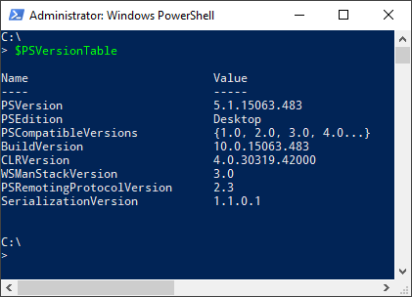
Sitecore Install Framework (SIF)
Prerequisites
PowerShell 5.0 or above
Web Deploy 3.6 for Hosting Servers
Dacpac support for Web Deploy
Installation
Register-PSRepository -Name SitecoreGallery -SourceLocation
https://sitecore.myget.org/F/sc-powershell/api/v2
Install-Module SitecoreFundamentals
Install-Module SitecoreInstallFramework
Notes:
The Sitecore Installation Framework is made available through the Sitecore Gallery. The Sitecore Gallery is a public MyGet feed that can be used to download and install PowerShell modules created by Sitecore.

Slide 4

xConnect

Slide 5
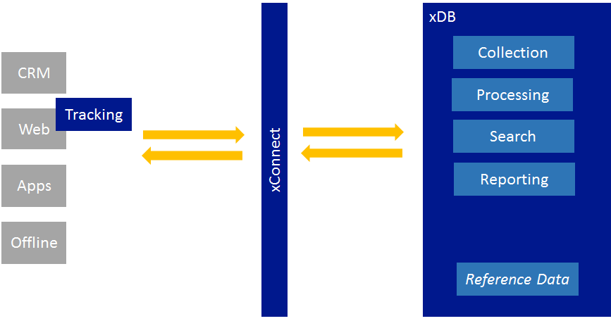


xConnect— Collect everything for exceptional and individual outcomes
xConnect is the service layer that
sits in between the xDB and any trusted client, device, or interface that wants to read, write, or search xDB data.
Communication must happen over HTTPS
and clients must have the
appropriate certificate thumbprint.
Any and all outcomes
Any and al interactions
Notes:
xConnect is today the service or integration layer that is located between xDB and any client, device, or interface that reads, writes or searches for data in xDB
Thus, in Sitecore we are able to efficiently collect all types of data from all touchpoints, all interactions between you and your customers.

Slide 6




Introducing xConnect for Experience Platform
Enable true omni-channel collection at scale
Website visits
Fit devices
In-store visits
Secure
xConnect is secure by default.
A bit more on GDPR and encryption later
Beacons
Call centers
IOT and
Any 3rd party data
xConnect
Full data interoperability between Sitecore and any 3rd party systems
Notes:
Back In Sitecore 7.5, we introduced xDB.
xDB is the scalable data repository where Sitecore has stored interaction data from the digital channels for several years.
xConnect is one of the cornerstones of Sitecore 9 - adding a number of essential elements to xDB and to Sitecore's platform as a whole.
By providing a uniform API for the entire platform, integration of external data becomes much simpler. Ie To scroll data collection In a modern omnichannel scenario, with the participation of many touchpoints, platforms, devices etc. becomes significantly simpler.
Sitecore's customers can therefore safely plan ahead for a future where data integration and open data APIs (as you've just heard from Forrester) only become more important.
All customers, Sitecore products, modules etc. communicate with xConnect. ? We are all in the same boat !!
With xConnect, access to data is even more open to 3rd party platforms, for example. BI tools and the like. Want direct access to real-time data via xConnect.
The openness of the platform provides easier access to data for the marketing employee, lower implementation costs and generally faster time-to-market.

Slide 7







Introducing xConnect for Experience Platform
Integrated ARM & Azure Marketplace setup
xDB
xConnect unlocks and expands database options for xDB
CosmosDB
*
*
*Delivered in updates
Notes:
Back In Sitecore 7.5 and until release of Sitecore 9, xDB was "available" only as a Mongo database ... .. With 9, we are expanding the choice of databases: CosmosDB and SQL Azure will become our de facto solutions for an integrated Azure ARM + Marketplace story with unified provisioning All new xDB Cloud customers will be on CosmosDB or SQL Azure; Ons konverteringsverktyg har været udvidet til at støtte alle, der ønsker at konvertere til en Microsoft-stack fra MongoDB til SQL MongoDB remains a great choice for on-premise or IaaS-based solutions where a NoSQL solution is preferred and people have the skills set

Slide 8






xConnect empowers new CRM connectors
Bi-directional data transfer to and from leading CRM systems
Personalize based on interactions that occur in the CRM
Support for Microsoft Dynamics 365 for Sales (CRM)
Add latest Digital Experience data into the CRM from xDB
Bring in CRM data to xDB for use with Sitecore Machine Learning
Support for Salesforce CRM
Notes:
Sitecore has created and supports connectors for SalesForce.com and Microsoft Dynamics CRM to interchange data between xDB and the CRM.
But Why does this matter? Marketers can use the information locked in their CRM to personalize the content, campaigns and commerce experiences delivered to their customers and prospects, and record their campaigns and customer interactions in the CRM for a more complete picture in both systems. The becomes even more powerful when blended with all of the other xDB and contextual data captured

Slide 9




xConnect data model
Contact
Interaction
Events
Facet
Facet
Goal
Outcome
Personal
Location
Addresses
Profile scores
More…
More…
Signed Up
Tour Purchase
Yours
Yours
Notes:
A contact represents an individual who interacts with or may potentially interact with your organization.
An interaction describes any point at which a contact interfaces with a brand, either online or offline. Examples of interactions include:
Purchasing a something from a physical store
Using an app
Browsing a website
A phone conversation
An event is anything significant that occurs within the context of an interaction, such viewing a web page or making a purchase in a physical store.
A facet is piece of information that enriches a contact or an interaction. For contacts, this might include their name and address. For interactions, this might include the location of the interaction.

Slide 10

GDPR & Privacy
https://www.eugdpr.org/

Slide 11
GDPR & Privacy
Platform supports features to help you become PII and GDPR Compliant
[PII Sensitive] attribute on Facets or individual Facet properties = (personally identifiable information)
Right to be forgotten (ExecuteRightToBeForgotten method)
Right for data portability
Data-in-Motion encryption supported

Slide 12
Sitecore Forms

Slide 13
A small mix… Federated Authentication Migration tools

Slide 14
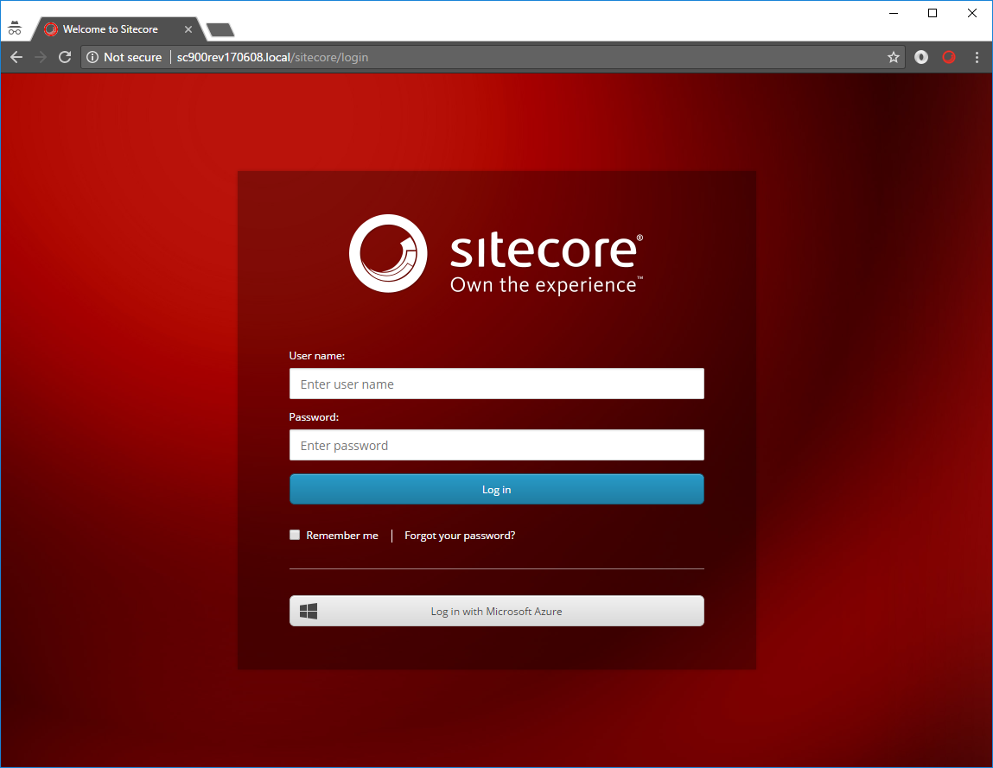
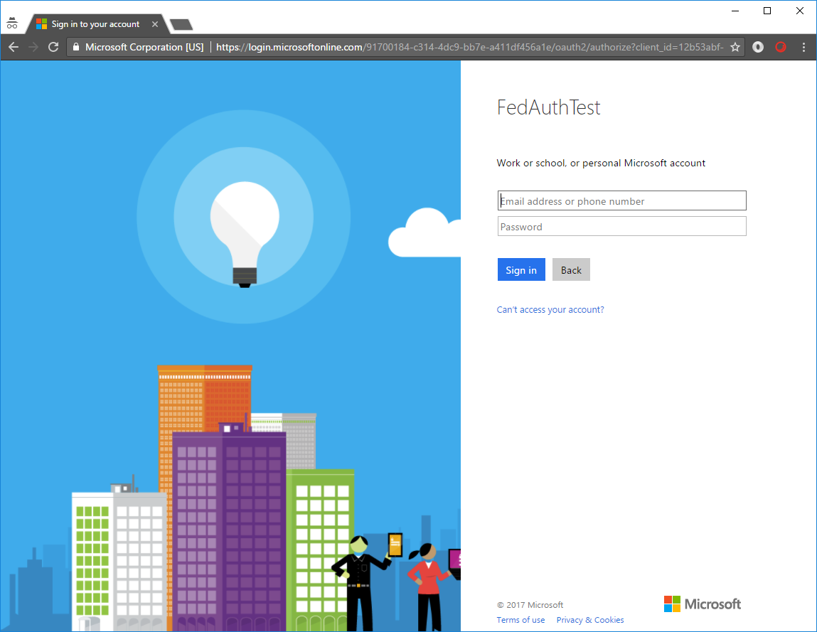
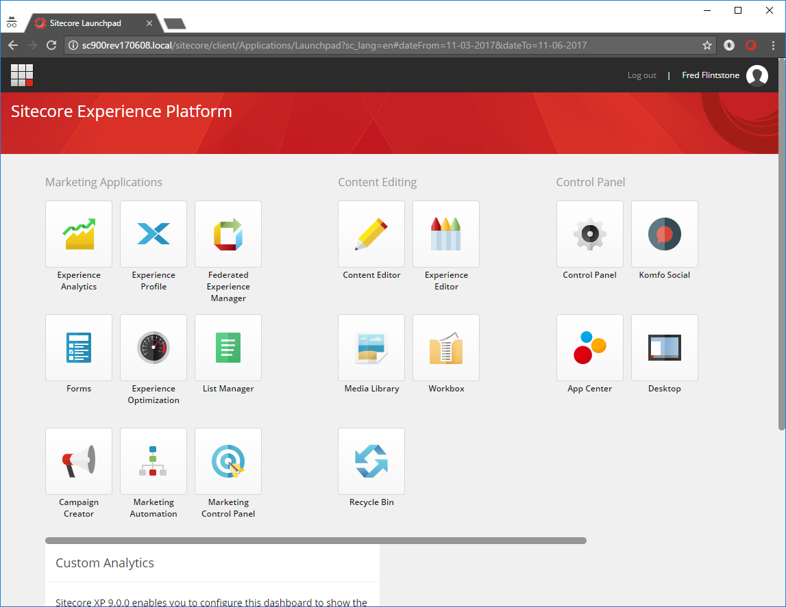
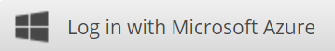
Federated Authentication
Federated Authentication
Flexibility to use other systems for authentication without writing a provider
Decoupling authentication. Abstract IIS from users. BYO user-management.
Works for Sitecore users as well as Website users.
Facebook, Google, Twitter, Azure AD, ADFS, AD, Jwt, Oauth and more…..
Notes:
In 9 we also have Federation Authentication support that includes Active Directory Federation Services (ADFS) and Azure Active Directory (AD) support so users can login via Azure Active Directory or any other OpenID Connect or SAML single-sign on authentication provider. This is for both the marketers’ access to Sitecore and for the visitors to log in to a website via Social IDs such as Facebook, Google, Twitter etc
HUSK at det er BÅDE til Sitecore og til almindelige brugere.

Slide 15
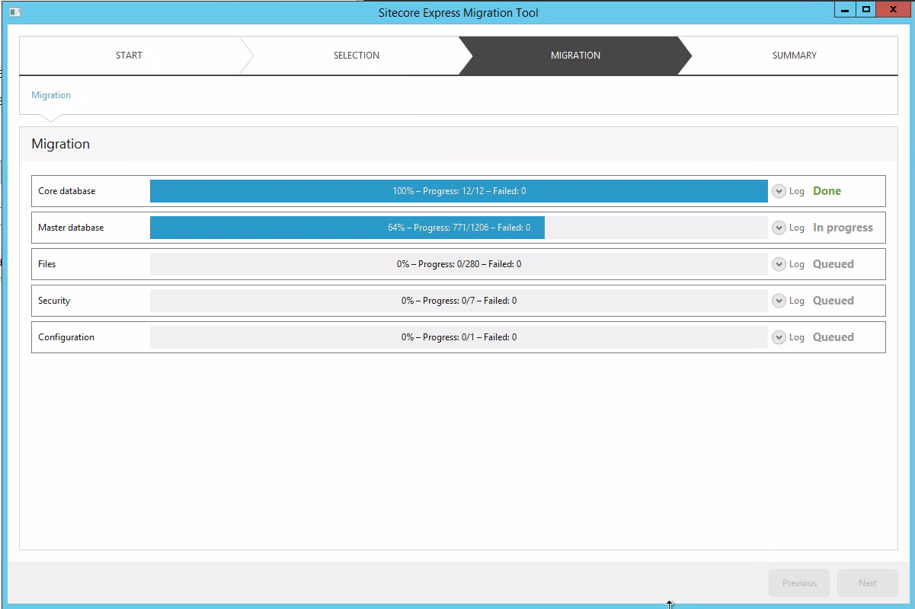
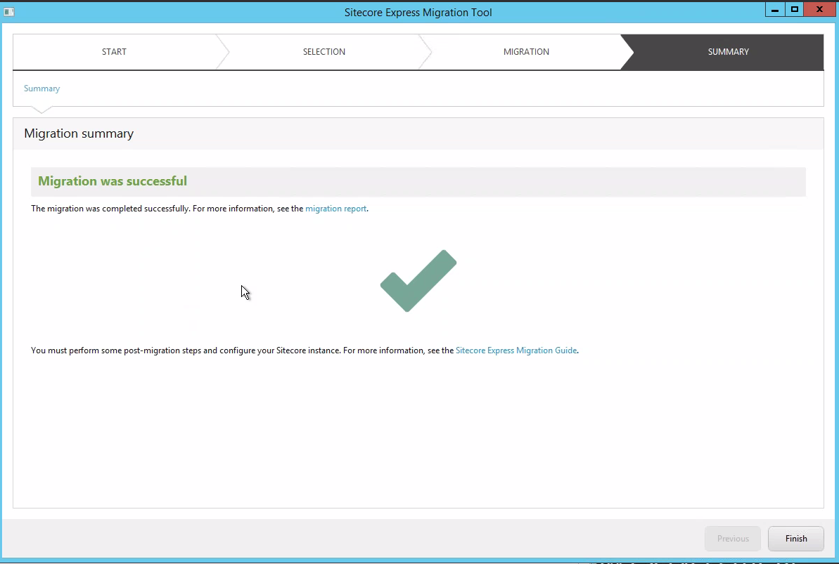
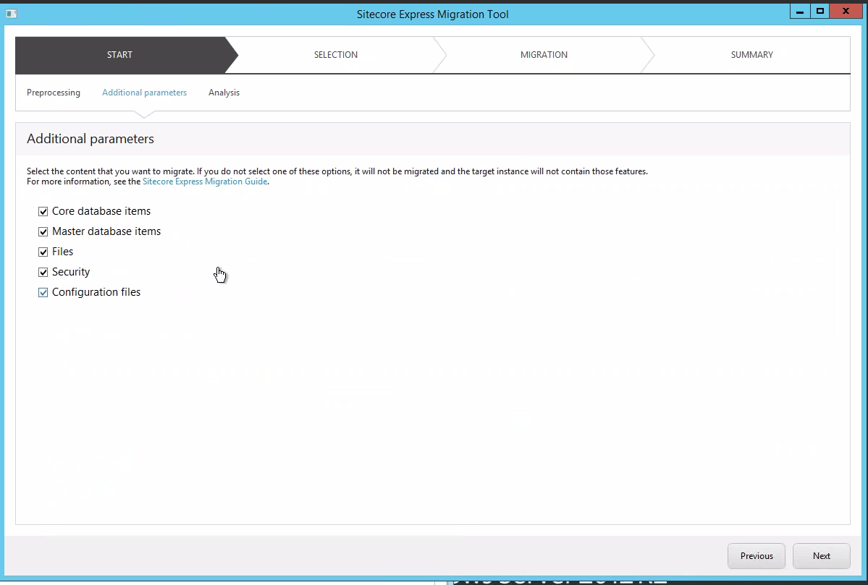
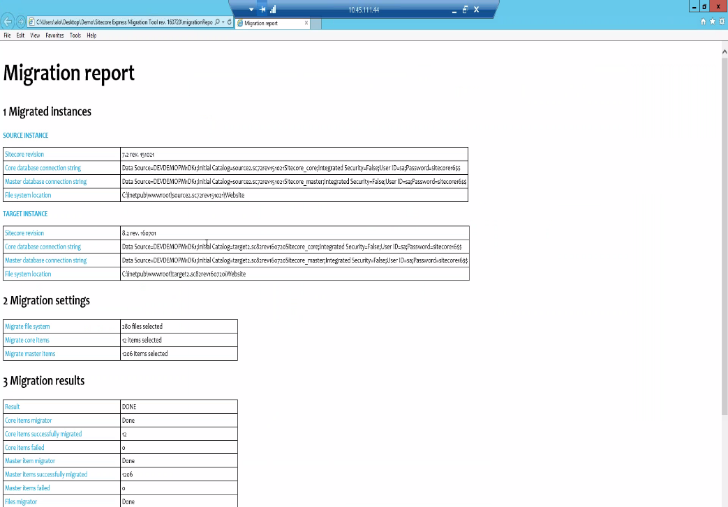
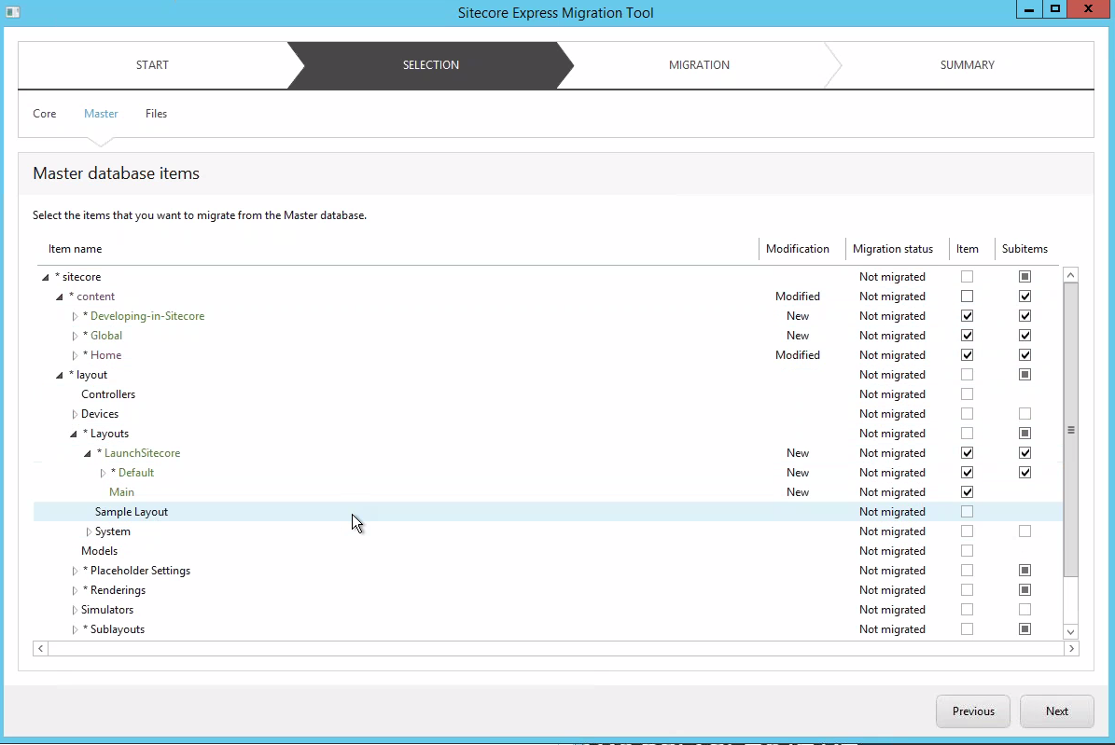
Streamlining migrations and upgrades
Migration Tool
More efficient way of moving from older versions to newest version of platform:
Through Express Migration 3.0
Support for 6.6, 7.2, 7.5, 8.0 → 9.0 GA
Support for WFFM
Quality improvements
Conversion Tool
xDB migration
© 2001-2017 Sitecore Corporation A/S. All rights reserved. Sitecore® and Own the Experience® are registered trademarks of Sitecore Corporation A/S. All other brand and product names are the property of their respective owners.
Notes:
In 9, Sitecore XM and XP offers migration and conversion tools for content that give customers on prior releases a far easier and efficient way to move data and projects forward into Sitecore 9.
It’s the easiest upgrade in Sitecore history with direct migration from legacy version to the latest and greatest!
This provides you with a lot more budget than before to improve your clients online presence and spend less time on the lift and shift.
As you can see those current on 6.6, 7.2, 7.5 and 8.0 can be migrated to 9.0.
Those on 8.1 and above can directly upgrade to 9.0
This version is also updated to allow the conversion of xDB date from MongoDB to SQL
--Next Slide--

Slide 16
Rule-based configuration
Rule-based configuration uses rule definitions that
you can set for each Sitecore instance.
Sitecore uses the values of these rule definitions to determine
whether Sitecore should apply the settings
from configuration files and patch files.
Example:
Define the role of the server in web.config
Define every setting on config files:
<AppSettings>
<add key="role:define" value="ContentManagement, Processing, Reporting"/>
</AppSettings>
<agent type="Sitecore.Tasks.HtmlCacheClearAgent" role:require="ContentManagement">
<patch:attribute name="interval">00:05:00</patch:attribute>
</agent>

Slide 17





Sitecore Experience Commerce™ on next episode ETA Jan 2018
Native
Personalization
Testing &
Optimization
Marketing
Automation
One Connected
Platform
17
© 2001-2017 Sitecore Corporation A/S. All rights reserved. Sitecore® and Own the Experience® are registered trademarks of Sitecore Corporation A/S. All other brand and product names are the property of their respective owners.
17
Notes:
Sitecore Commerce is unique in market with:
Native personalization
Testing + Optimization
Marketing Optimization
All through One Connected Platform

Slide 18
